Slide 1
Module: Develop Enterprise Applications Qualification: Professional Diploma in Web Development
Introduction to Spring Boot
By the end of this tutorial you will be able to understand the basics of Spring Boot.

Slide 2
Contents
S. No. | Topic Description | Required / Optional
01 |  | Required
03 |  | Required
04 |  | Required
05 |  | Required
06 |  | Required
07 |  | Required
08 |  | Required
09 |  | Required
10 |  | Required

Slide 3
Introduction to Spring Boot
Create stand-alone Spring applications
Embed Tomcat, Jetty or Undertow directly (no need to deploy WAR files)
Provide opinionated 'starter' dependencies to simplify your build configuration
Automatically configure Spring and 3rd party libraries whenever possible
Provide production-ready features such as metrics, health checks and externalized configuration
Absolutely no code generation and no requirement for XML configuration

Slide 4
System Requirements
Spring Boot 2.1.6.RELEASE requires Java 8 and is compatible up to Java 11 (included).
Spring Framework 5.1.8.RELEASE or above is also required.
Explicit build support is provided for the following build tools:
Spring Boot supports the following embedded servlet containers:
Build Tool | Version
Maven | 3.3+
Gradle | 4.4+
Name | Servlet Version
Tomcat 9.0 | 4.0
Jetty 9.4 | 3.1
Undertow 2.0 | 4.0

Slide 5
Installation Instruction
You can use Spring Boot in the same way as any standard Java library.
Include the appropriate spring-boot-*.jar files on your classpath.
Spring Boot does not require any special tools integration, so you can use any IDE or text editor.
You can run and debug a Spring Boot application as you would any other Java program.
You could copy Spring Boot jars
Recommend that you use a build tool that supports dependency management (such as Maven or Gradle).

Slide 6
Notable Features
Auto-configuration:
Sets up your application based on the surrounding environment, as well as hints what the developers provide.
Standalone:
It's completely standalone. Hence, you don’t need to deploy your application to a web server or any special environment. Your only task is to click on the button or give out the run command, and it will start.
Opinionated: This means that the framework chooses how to things for itself. This is the point where a lot of people says "wait a minute, I do not want to participate in it." Here I encourage you to wait for a second and hold your judgment for now, because, actually, it can be a good thing.

Slide 7
Difference Between Spring & Spring Boot
Basis | Spring | Spring Boot
Configuration | To design any spring based application, a developer needs to be taken care on manual set up on Hibernate data source, Entity Manager, Session Factory, Transaction Management everything. | To Design all those common set up, a developer doesn’t need to define everything individually, SpringBootConfiguration annotation enough to manage everything at the time of deployment.
XML | Spring MVC application some of the XML definition mandatory to manage. | Configuring Spring Boot Application nothing needs to be managed, the only annotation managed everything.
Controlling | As configuration can be easily handled by manually, so Spring or Spring MVC can manage to not loading some of the unwanted default features for that specific application. | In case of Spring Boot, it automatically handled on default loading part, so the developer doesn’t have as such concept of not loading some of the specific unusable spring default features.
Use | Better to use if application type or characteristics are purely defined. | Better to use where application type of functionality for future use not properly defined. As integrating any Spring specific feature will be auto-configured in here, so no need any additional configuration.

Slide 8
Project Setup Steps
Create project from Spring Initializer as shown below slides
Configure your IDE (Spring Tools Suite or Eclipse) for Lombok
Start the IDE and import the starter project created in 1st step.
File -> Import -> Existing Maven Project
Examine the directory structure of project and following files:
pom.xml
application.properties
ApplicationTest.java (it may be AppApplicationTest.java or something else)
Application.java (it may be AppApplication.java or something else)

Slide 9
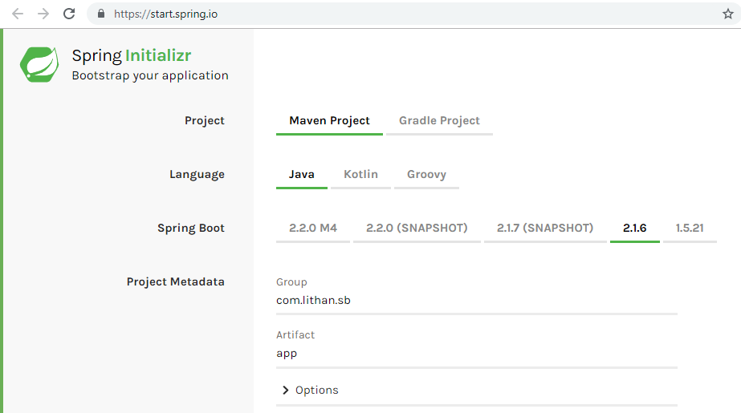
Spring Initializer - Basic Configuration

Slide 10
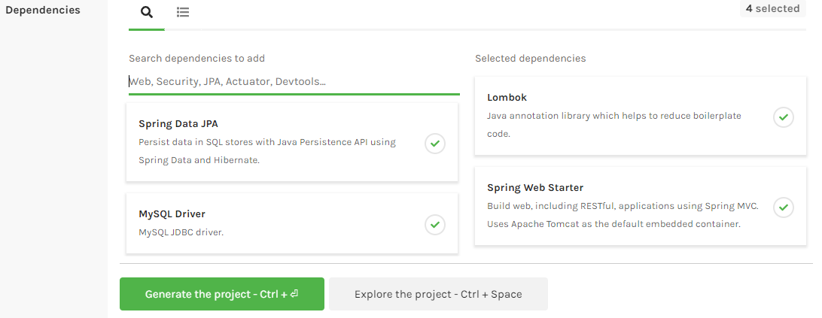
Spring Initializer - Dependency Management

Slide 11
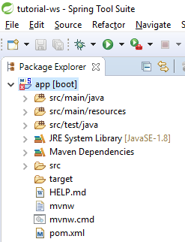
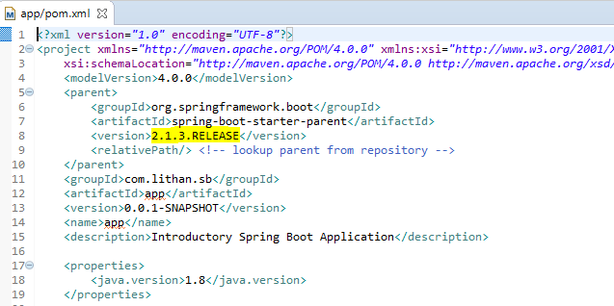
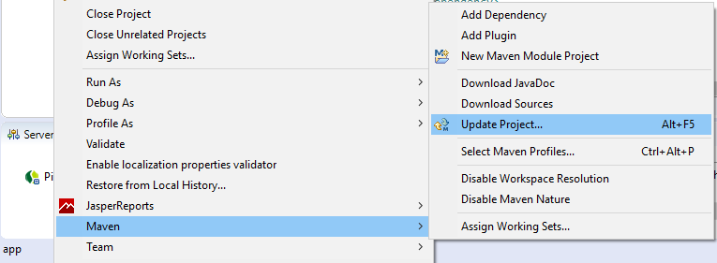
Fixing Version Error - Only if needed!
1
2
3

Slide 12
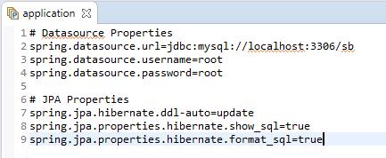
Update application.properties
We need to create a Schema in MySQL and mention it's name in this property file.
For tutorial purposes, we will use the schema name “sb” which stands for Spring-Boot.
Then we need to update application.properties to point to our MySQL instance on localhost.
The JPA properties ensures that Tables in Schema are automatically created/updated in case of changes in our Java Domain Objects.
We are also enabling “show_sql” and “format_sql” property to see Hibernate generated queries in a well formatted manner.

Slide 13
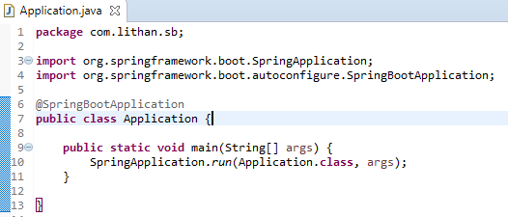
Spring Boot Application
This is the main class which is entry point for any Spring Boot Application.
It is annotated with @SpringBootApplication which takes care of Auto-Configuration of your Boot Application, Component Scanning, IOC Container Initialization and also adds @Configuration annotation to your main class.
The key feature of Spring Boot Application is it's starter POMs and auto-configuration which enables us to focus on writing business logic with very minimal setup, without worrying about writing any boiler-plate configuration code.

Slide 14
Application Structure
Objective of this tutorial is to create REST APIs in Spring Boot which allows end-user to perform following tasks:
Register themselves to our Application Platform.
See the list and details of all users
Update and delete their details.
Layers of Application:
Model - Contains Java Domain Objects
Dto - Contains Data Transfer Objects
Projection - Contains Projection Interfaces as alternative to Dtos.
Repository - Jpa Interfaces and Implementations for Persistence Layer
Service - Business Logic Implementation and Transaction Management.
Controller - REST Controllers for various API end-points.
Constants - Interfaces containing constant values as best practice.
Exceptions - This layer defines all the custom exceptions.

Slide 15
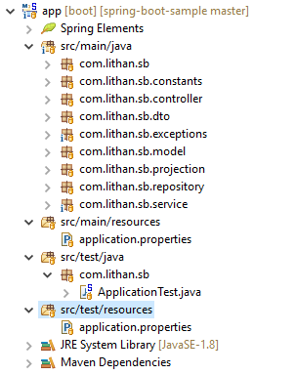
Project Structure

Slide 16
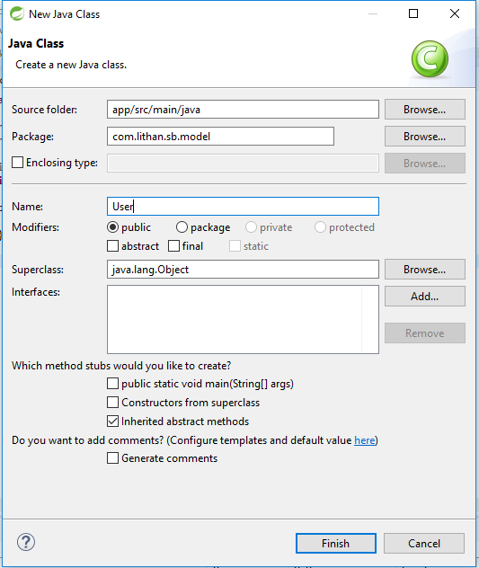
Let's get started!!!
The crux of any Enterprise Application lies in it's Data Design.
We start Data Designing by creating User model.
File -> New -> Class
This model will contain basic details of the user.
User model will also have Associations will Address and Role model.

Slide 17
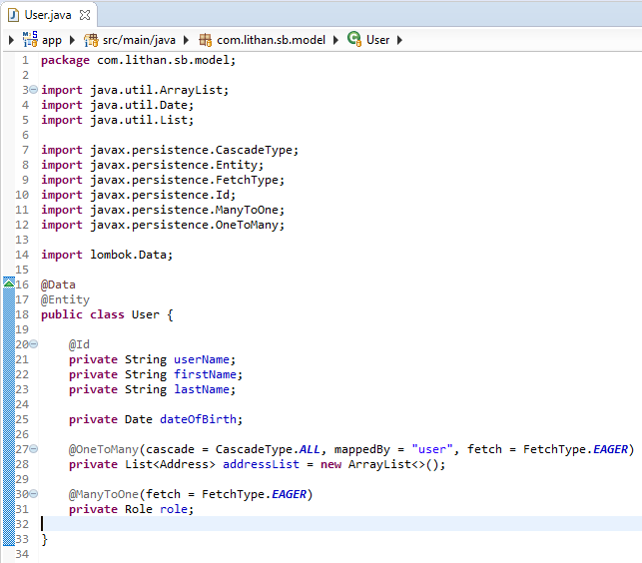
User.java

Slide 18
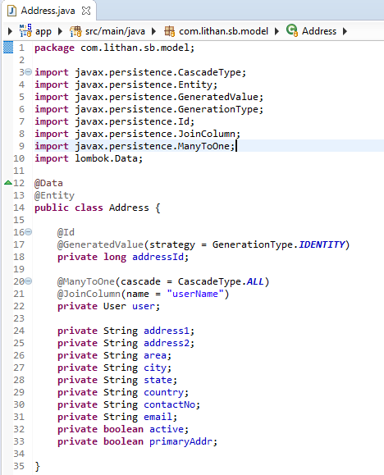
Address.java

Slide 19
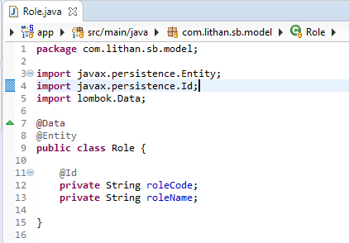
Role.java

Slide 20
Dtos and Projections

Slide 21
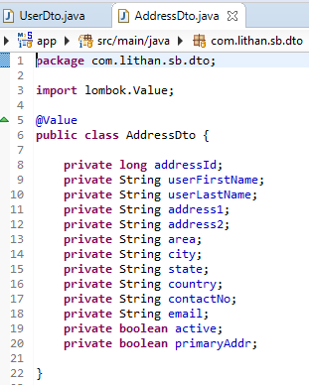
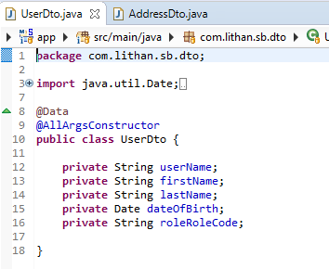
UserDto.java and AddressDto.java

Slide 22
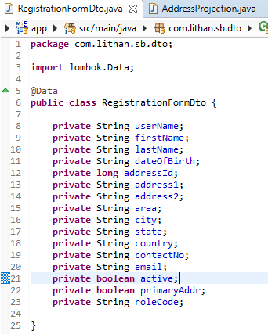
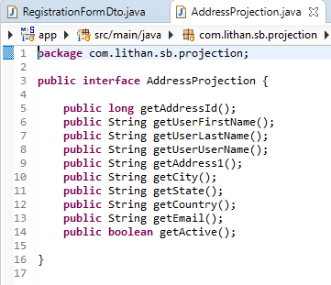
RegistrationFormDto.java & AddressProjection.java

Slide 23
Exceptions
Custom Exception Handling Mechanism through RuntimeException extended classes

Slide 24
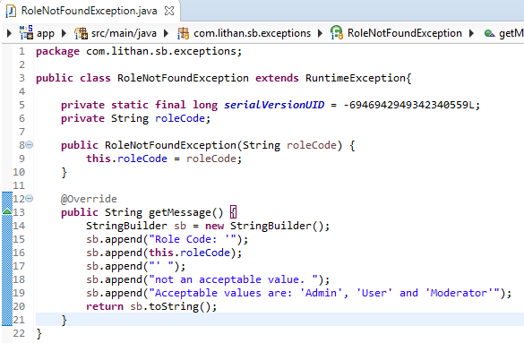
RoleNotFoundException.java

Slide 25
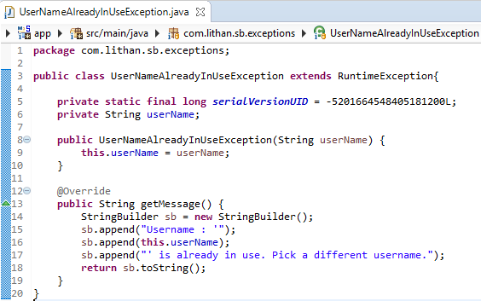
UserNameAlreadyInUseException.java

Slide 26
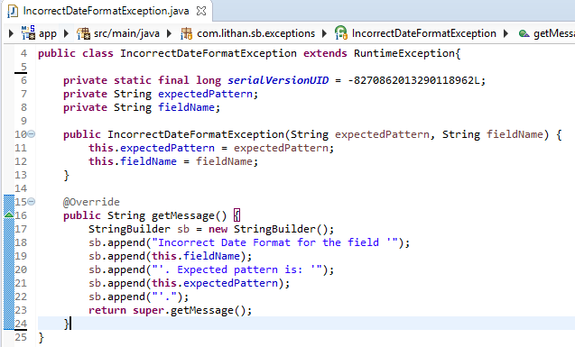
IncorrectDateFormatException.java

Slide 27
Repositories
Persistence Layer

Slide 28
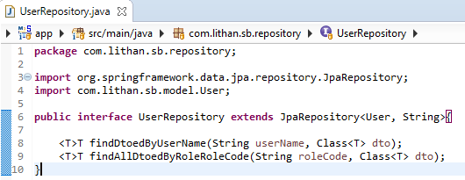


Repositories

Slide 29
Service
Business Logic Layer

Slide 30
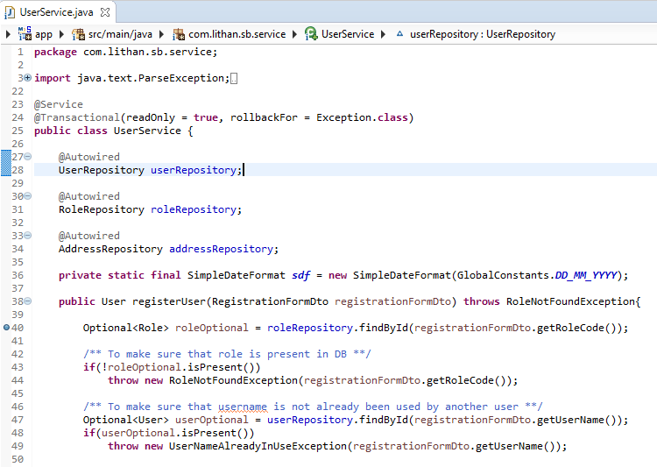
UserService.java - Part 1

Slide 31
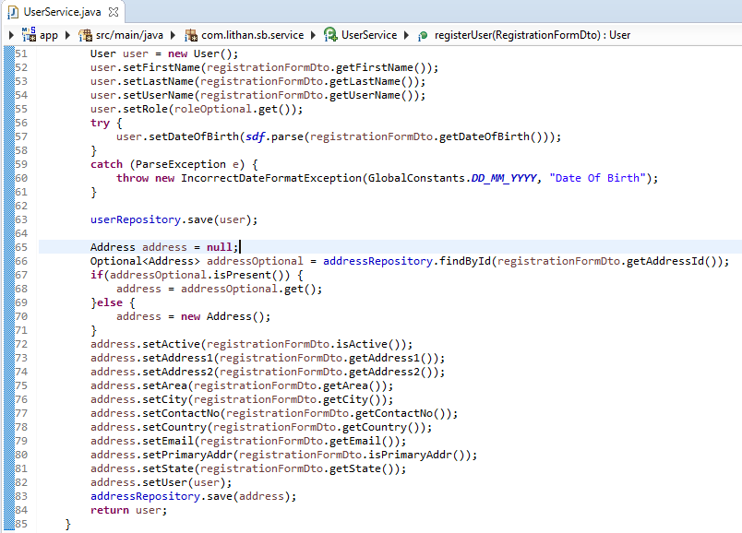
UserService.java - Part 2

Slide 32
Rest Controller
API Layer

Slide 33
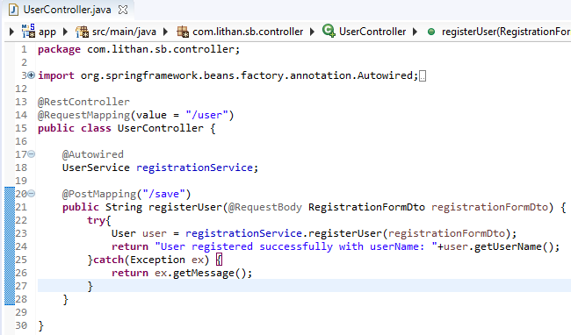
UserController.java

Slide 34

THANK YOU

